Slide 1
Communication with businesses and response burden
Deirdre Giesen & Ger Snijkers
EESW 9-11 September 2013

Slide 2
Outline
Overview “communication findings” BLUE-ETS
Recommendations for NSI communication with businesses
Directions for further research

Slide 3

Acknowledgements
BLUE-ETS deliverables 2.1 2.3 3.1.3.2 8.1; workshop on communication (Brussels 27-11-21012) www.blue-ets.eu
CBS Deirdre Giesen, Vanessa Torres van Grinsven, Ger Snijkers et al.
University of Ljubljana: Mojca Bavdaž, Irena Bolko et al.
SSB Gustav Haraldsen, Oyvin Kleven, Tora Löfgren, Dag Gravem et al.
SCB: Boris Lorenc, Andreas Persson et al.
SORS: Rudi Seljak et al.
University of Bergamo: Sylvia Biffignandi et al.
CEPS: Mikkel Barslund et al.
Ger Snijkers & Jacqui Jones (2013) Business Survey Communication Chapter 9 in “Designing and Conduction Business Surveys”

Slide 4
BLUE-ETS research on burden and motivation
Measurement and reduction of response burden in official business surveys NSIs practice | Businesses’ perspectives on official statistics e.g.
Case studies
Analyses of data on burden and response behaviour in Sweden, Norway and Netherlands | Studies on effects of actions to reduce burden and/or increase motivation: Experiments on improving motivation in Sweden and Slovenia, studies on effects of questionnaire design in Norway and The Netherlands

Slide 5
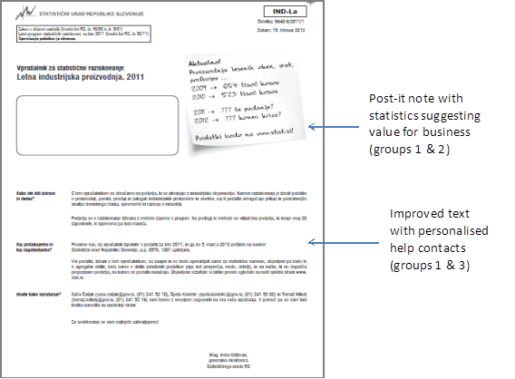
Slovenian experiment (Bavdaž & Bolko 2013)
Notes:
5

Slide 6
Framework for NSI communication and response behaviour
Communication
initiated by NSI
Survey communication
Corporate image of NSI
Costs and benefits of responding
Response behaviour
Costs and quality of data collection
Output-related communication
Communication in the media about surveys and statistics

Slide 7
Results case studies 1
Response burden related to response behaviour, eg. more burden: lower and later response, more edits needed
Perceived burden related to actual burden but also by perception of NSI and usefulness statistics

Slide 8
Results case studies 2
Experiments aiming at increasing motivation by better communication did not show many of the expected effects.
The two questionnaire studies showed that questionnaire redesign can reduce actual and perceived burden

Slide 9
Recommendations

Slide 10
Promote consistent and positive image
Show in all types of communication that NSI is
thrustworthy
friendly
professional
produces valuable output
and cares about both response burden and quality.

Slide 11
Build relationships
Build and manage relationships with key stake holders in business world (e.g. advisory councils with representatives of business as users and providers of data; contacts with business organisations; outreach activities).
Develop and promote dedicated output relevant to target groups in business world (e.g. statistical packages for starting your business, statistical package for market research, quick scan for benchmarking).
Communicate about these things
….

Slide 12
pre-field survey communication
Know respondents (e.g. record keeping studies, profiling of large businesses)
Keep registers and contact information up to date
Use survey calendars to help business plan their resources
…

Slide 13
field survey communication
Provide clear address information on envelope
Indicate Unit / Reporting period / Deadline on letter ánd questionnaire
Be clear about mandatory status, but do not stress immediately
Provide appealing reasons for need of the survey request
Use incentives (?)
Provide efficient assistance for questions and complaints (e.g. website, helpdesk, complaint procedures)
Provide single point of contact for large enterprises
Document special arrangements for respondents
Indicate changes in questionnaire
User-friendly questionnaires
…

Slide 14
Post-field survey communication
Provide feed-back about status of submitted questionnaire
Plan follow-up calls as quickly as possible after submission of questionnaire
Use information of past response behaviour for design of follow-up strategies / sanctions
…

Slide 15
Directions future research
Focus on communication for SMEs
What are effective strategies to affect response behaviour?
What motivates respondents besides surveys being mandatory?
How to explain the relevance of a survey to a business?
If and how to work with incentives
Should we include information in letters about how long it takes to complete?

Slide 16
How to make progress
Involve businesses organisations and businesses in design of surveys and other communications aimed at businesses
Bring in theories form various disciplines
Study actual behaviour of business respondents
Collect management info to monitor data collection process
Evaluate results of actions
Try to do experiments or pilot studies
Document and share work done

