Slide 1
Macroeconomic indicators for the EU economy
Robin Smail
Consultant and Visiting Expert EIPA

Slide 2
Part I. EU economy – key economic data
Economic performance:
size of economies: GDP, GNP, GNI (& populations)
economic growth
average income levels
regional income levels
macroeconomic stability
  inflation
  budget deficit
  public sector debt
reflecting trade, savings and investment, R&D, productivity performances

Slide 3
Part II. EU economy – work & incomes
Whose wealth is it?
unemployment rates
employment rates
breakdown of employment
(income disparities & wealth distribution)
(low pay and poverty)
(taxes and tax burdens)

Slide 4
Part I. Key economic data
A1: Size of economies (GDP)
Measuring national income:
National Income
Y = gross wages + profits + rent + interest
National Output
Q = Σ V.A. [ ie value added (all businesses, including the institutional sector) ]
National Expenditure
EXP = C + I + G + (X – M)

Slide 5
A1: Size of economies (GDP)
Different definitions:
GDP = Gross Domestic Product
  measure of output from national territory, regardless of ownership, before deducting capital depreciation.
GNP = Gross National Product
  measure of output from nationals of a country, including earnings abroad, excluding foreign incomes at home, before deducting capital depreciation.
  NNP (net national product): subtracts capital depreciation from GNP.
GNI = Gross National Income
  that is, GNP less indirect business taxes plus subsidies to business
  NNI is GNI less capital depreciation

Slide 6
A1: Size of economies (GDP)
Highlights:
EU (€12.5 tr) well ahead of USA (€11 tr) in 2010/2011 - in EURO terms – but this fluctuates; ... much closer at PPS
Germany is the largest EU economy at €2,500 billion
France now well ahead of UK (€2 trillion vs. €1.7 tr), Italy falling behind
figures revised for 6 years...
NB: Size of economy = population x average income (GDP per capita)

Slide 7
A2: Economic growth rates
Highlights:
global financial crisis: revised growth rates very much lower
growth rates collapsed in 2008 & 2009, especially the Baltic States
growth rates had been high in EU12 and IE
only Poland was growing still in 2009...
some growth again in 2010 (except GR, IE, ES, RO)

Slide 8
B1: National average incomes (GDP per capita)
Size of economy = population x GDP per capita
GDP per capita = size of economy / population
Which is growing faster? GDP or GDP per capita
Euro terms (exchange rates applied)
PPS or PPP (purchasing power standard / parity: to allow for price differences)

Slide 9
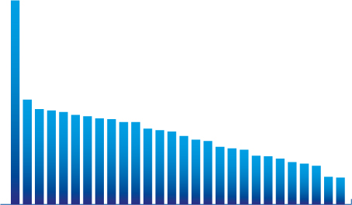
National GDP per capita
GDP per inhabitants in Purchasing Power Standards, 2007
Index where the average of the 27 EU-countries is 100
280
144
131
129
127
123
121
118
117
113
113
104
102
100
94
89
87
79
77
75
67
66
63
58
56
53
38
37
Ireland
Sweden
Malta
Portugal
Estonia
Hungary
Austria
Finland
France
Slovakia
Poland
Latvia
Romania
Spain
Bulgaria
EU-27
Cyprus
Belgium
Germany
Italy
Greece
Luxembourg
Denmark
Slovenia
Lithuania
Netherlands
United Kingdom
Czech Republic
Notes:
9

Slide 10
B1/B2/B3: National average incomes
GDP (PPS) per capita: EU27 average (€) 24,000
GDP (PPS) per capita: EU15 average (€) 26,000
Japan at 27,000 and USA at 35,000
smaller, wealthier western EU countries near 30,000; Luxembourg double that!
Ireland was the success story
CZ has overtaken PT
index makes trends easy to read eg. DK, SK, LV
gaps are wider if in Euro terms; narrower for PPS: see DK, SK, LT, LUX

Slide 11
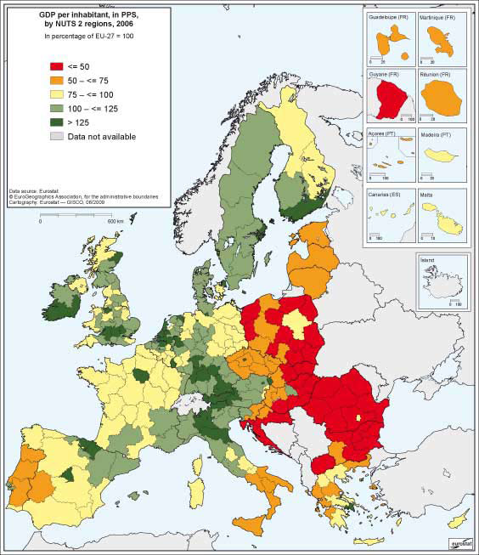

Slide 12
B. Regional average incomes
extremes are clear on the map: EU2 well behind EU10
Mediterranean areas slowly rising
some city-regions in EU10 are already catching-up with the south
beware of GDP being created in urban centres and much of working population living outside city boundary: Hamburg, Brussels, London
average regional growth in some recent years:

Slide 13
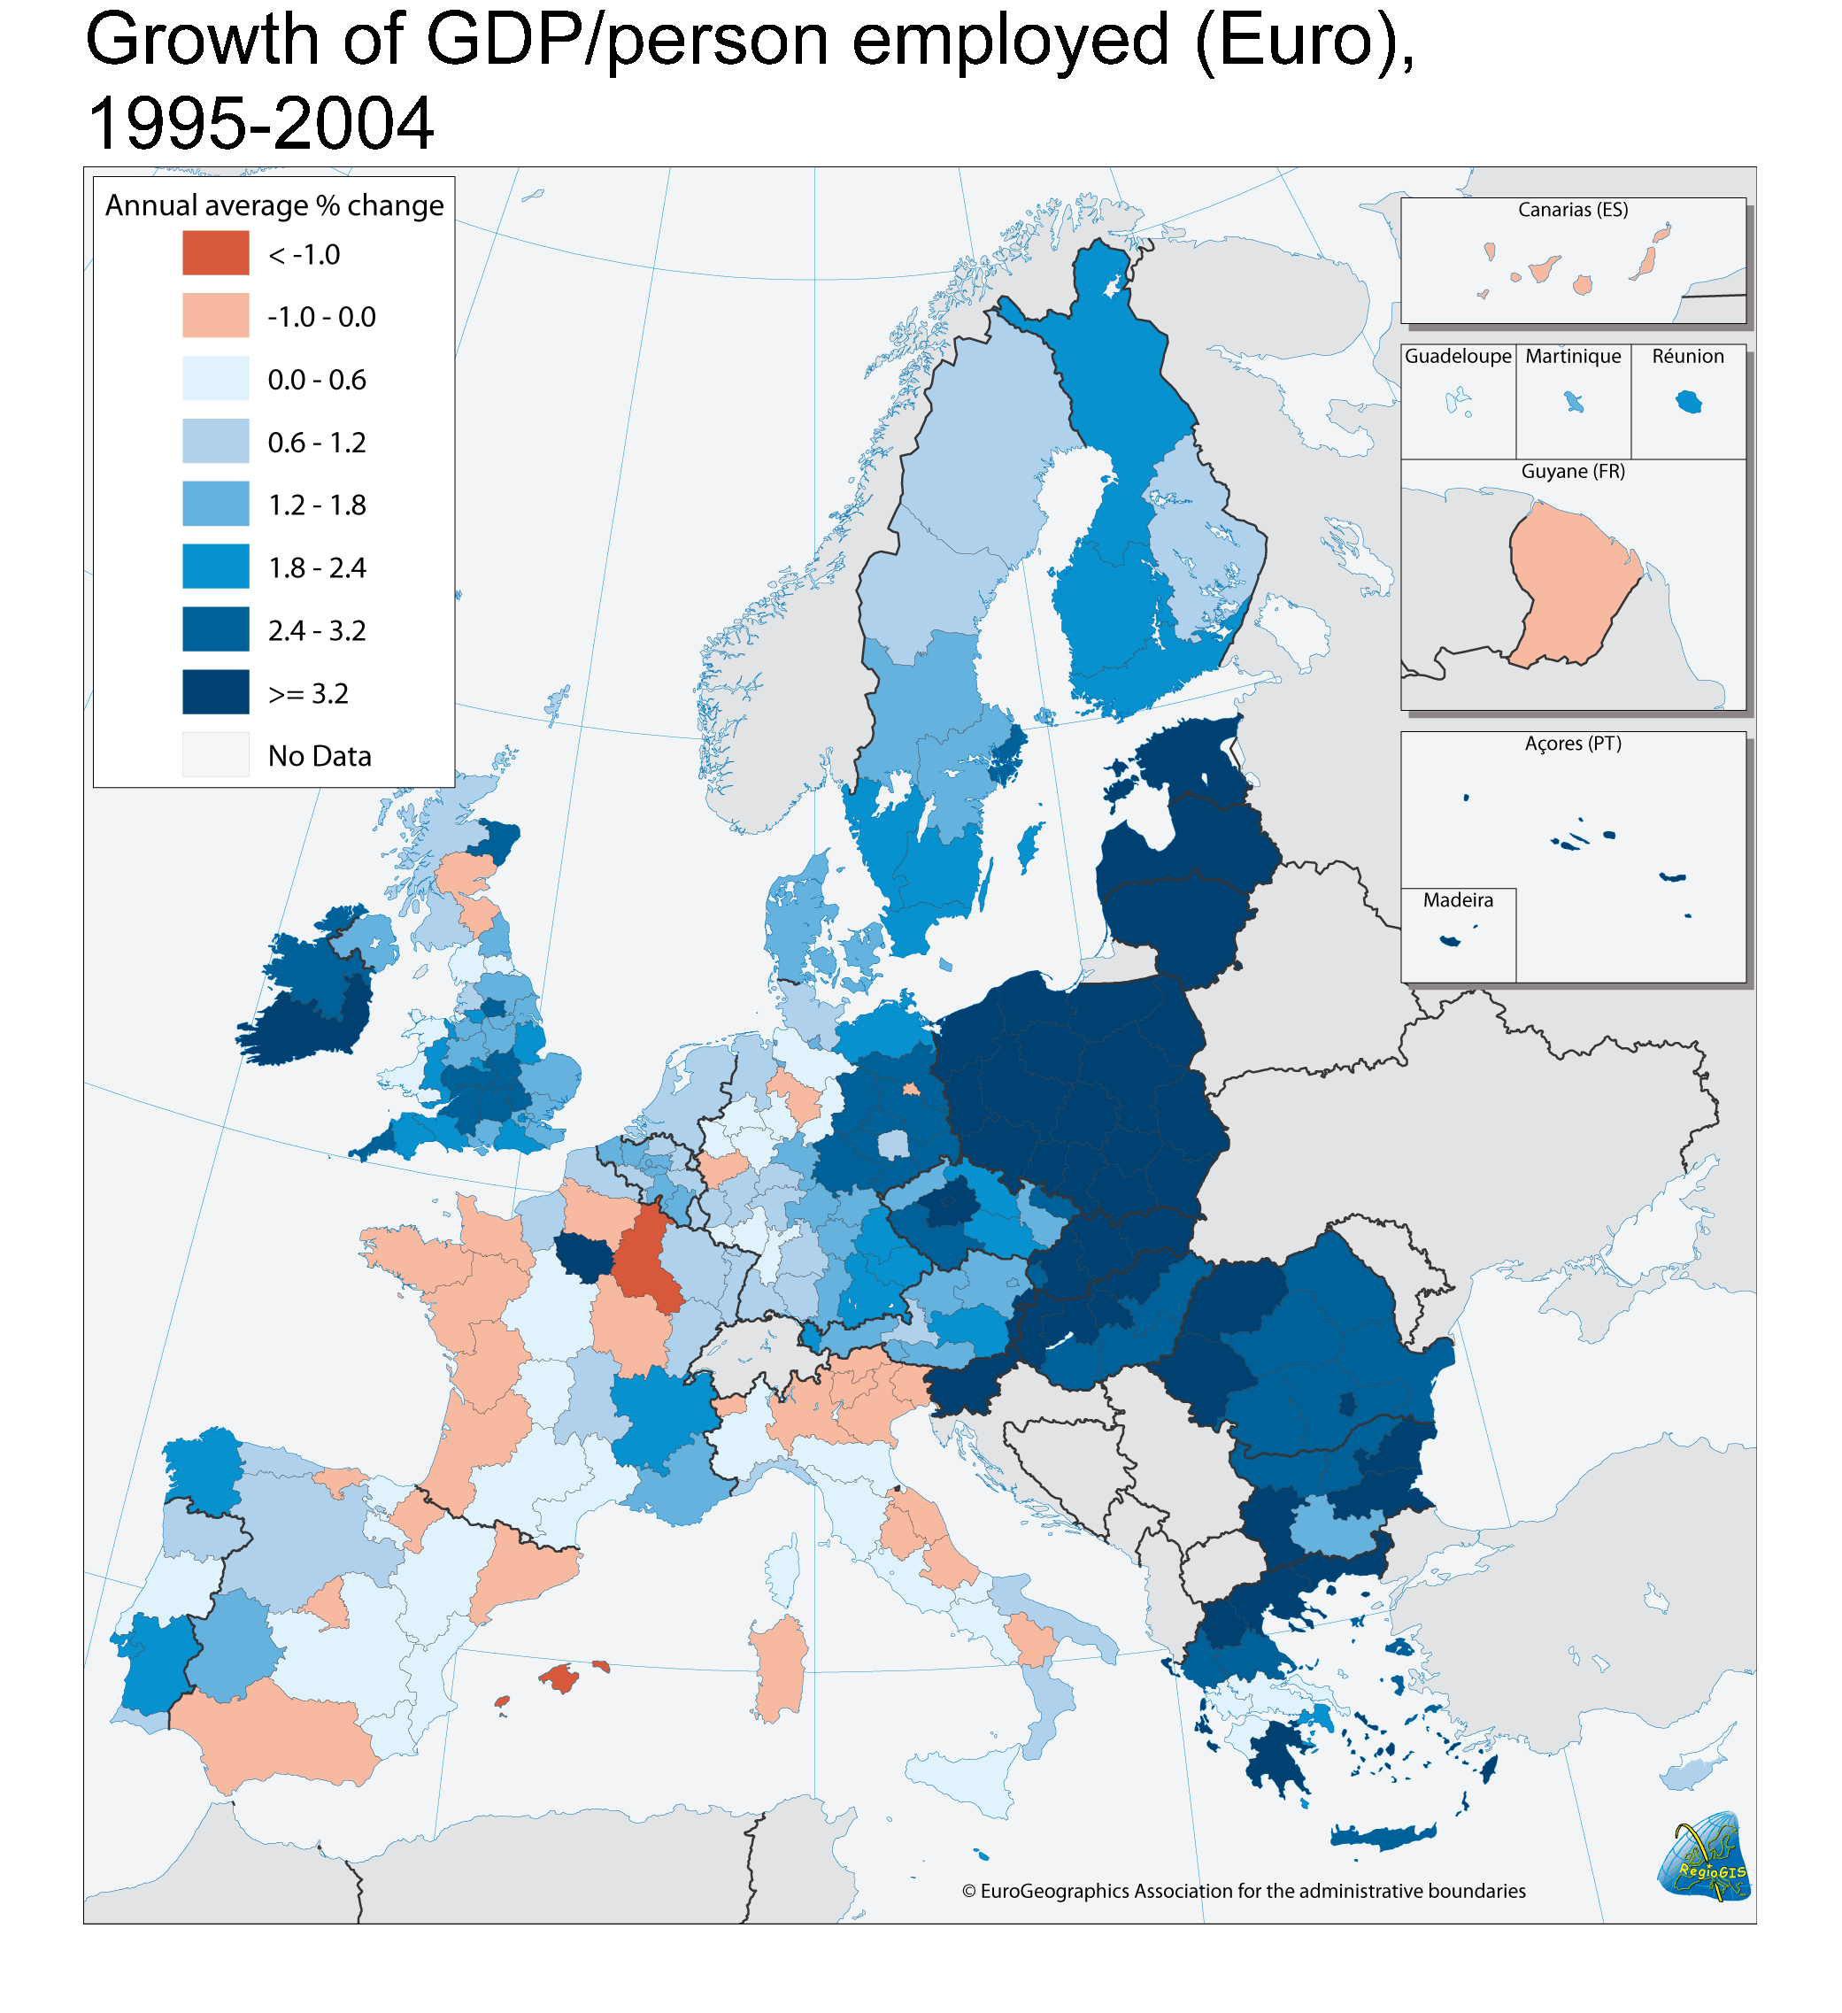
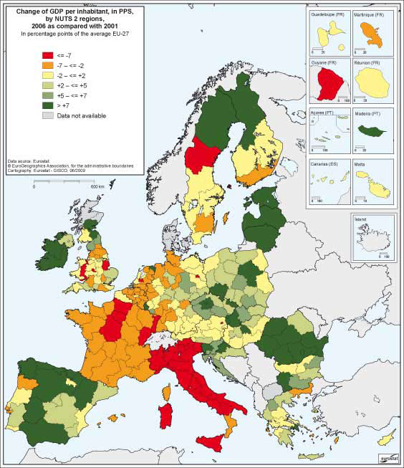

Slide 14
C: Inflation rates
Highlights:
Convergence/SGP criterion: up to 1.5% above best 3 in Euro-zone
Baltic states had highest rates (over 10%) until crisis, plus BG, RO, HUN had problems
Turkey, Romania had already addressed a major problem
prices were rising in 2008 (oil and food etc.), then the crisis; inflation rising again in 2010/11
Japan has seen deflation for years

Slide 15
D1: Share of Public Sector
Who has the largest government sector?
Scandanavia (55-60%)
BEL, FR, IT, AUT (around 50%)
UK, Germany (around 45%)
some of EU12 (around 35%)
...all have increased during economic crisis
compare to USA...
topic: how to pay for this?

Slide 16
D2: Budget deficits
Highlights:
Convergence/SGP criterion: 3% of GDP limit
Greece, Germany, Portugal, France had been over 3% of GDP before recession…
now only DK, EE, LUX, FIN, SWE below 3%
well at 10% and more for GR, ESP, IE, UK!!
rose rapidly for UK, IE, BEL, NL, LV due to financial crisis
USA and Japan traditionally have higher deficits

Slide 17
E1/E2: Public sector debt
Highlights:
Convergence/SGP criterion: 60% of GDP limit, or trend…
Italy, Greece, Belgium were famously over 100% of GDP!! Belgium (and Greece) debt was falling, but...
a group were at 60% of GDP; Euro area rising fast...
UK and others were around 40%... rising fast...
some very low rates in new MS
Japan is exceptionally high (160%)
topic: can a country sell its bonds??

Slide 18
F: Trade balances
Balance of payments has 2 principal elements
CURRENT ACCOUNT: (income flows)
Visibles: goods/merchandise trade (raw materials, machines)
Invisibles: trade in services eg tourism, education, transport, financial etc. + investments income/costs
CAPITAL (and Financial) ACCOUNT: (assets)
investments in capital assets
investments in national bonds & securities
(foreign exchange reserves, incl. gold)

Slide 19
F1/F2: Trade balances
Highlights for CURRENT ACCOUNT:
Germany leads the world on exporting goods (or China??)
Northern surpluses: SWE, NL, FIN, BEL….
Euro area just positive
PT, ESP, UK, IRE, GR unhealthy
some EU12 switched from negative to positive with recession
reflects sectoral strengths:
German manufacturing
UK strong on services (& energy)

Slide 20
F: Trade balances
How open is your economy?
Can refer to labour migration, investment, technology transfer, but……
usually proportion of national output/income which is exported / imported?
World average was 15%..
UK, FR, IT was 26-28%
Scandanavia at 40%
Netherlands has Rotterdam….60%
Belgium at 80%
...smaller economies more open...

Slide 21
G: Foreign Direct Investment
Part of CAPITAL (and Financial) ACCOUNT:
2000 was a peak - halved by 2003 – was growing until 2008
importance for Ireland, Belgium, …Luxembourg!
other FDI destinations: significant sums now to Malta, BG, HUN, EE (plus CZ, SK, PL, RO…)
USA dominates inward investment from outside EU (to UK, NL, BEL, ESP)
EU outward greater than inward (FR and UK dominate)

Slide 22
H: Labour costs, productivity and unit labour costs
GDP per capita proxies labour costs
Portugal and Greece lowest in EU15
most of EU12 has very low labour costs
wage pressure and indirect labour costs
productivity reflects investment in capital and RTD and innovation (not uniform across sectors)
Note: unit labour cost is a measure of "competitiveness"

Slide 23
Part II. Work and Incomes –
Whose wealth?
regional divergence of GDP
variation by income group and social class
poverty/deprivation measurement
unemployment (and long-term disability)
  restructuring economies
  massaging figures
employment with low pay (the poverty trap?)

Slide 24
I: Unemployment
UN = UN / UN + N (where N is employment)
Unemployed = signing on?
Unemployed = looking for work
(NB: national v. ILO definitions)
UN + N = economically active (labour force)
employment is = full-time + part-time numbers

Slide 25
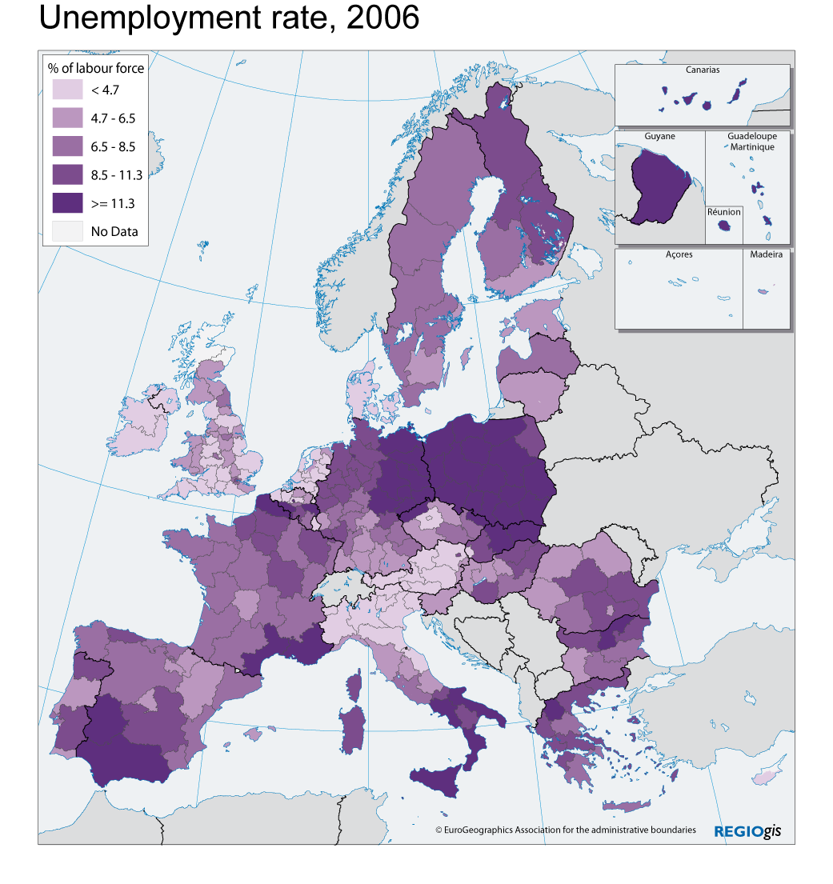
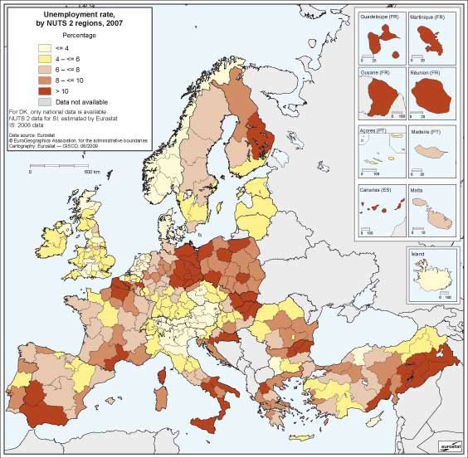
Unemployment
% of labour force
< 4.75
< 4.75 - 7.65
< 7.65 - 10.55
10.55 - 13.45
>= 13.45
No data
EU-27 = 9.1
Standard deviation=5.86
Source:
Eurostat and NSI

Slide 26
I: Unemployment
Highlights:
Spain, Poland and Slovakia were at 20%, but there were huge reductions..
  basis of calculation? migration? re-structuring?
EU and euro-zone levels have risen from 7% to 10% in 2-3 years (FR at 10%)
now huge increases again.... Spain, Ireland, Baltic States.....
major problems regionally, and with certain groups, such as youth unemployment, long-term unemployed
... what of women leaving labour market?
26

Slide 27
J: Employment rates
employment rate = numbers with jobs / working-aged population (aged 15-64)
economically active (N+UN) = labour force
N + UN / working-aged population = labour force participation rate

Slide 28
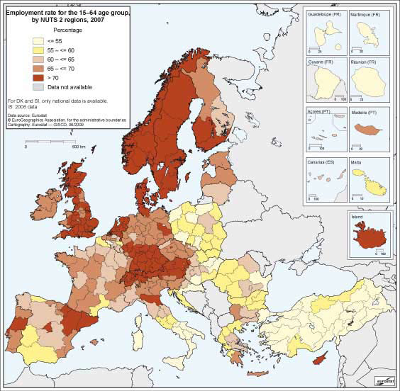
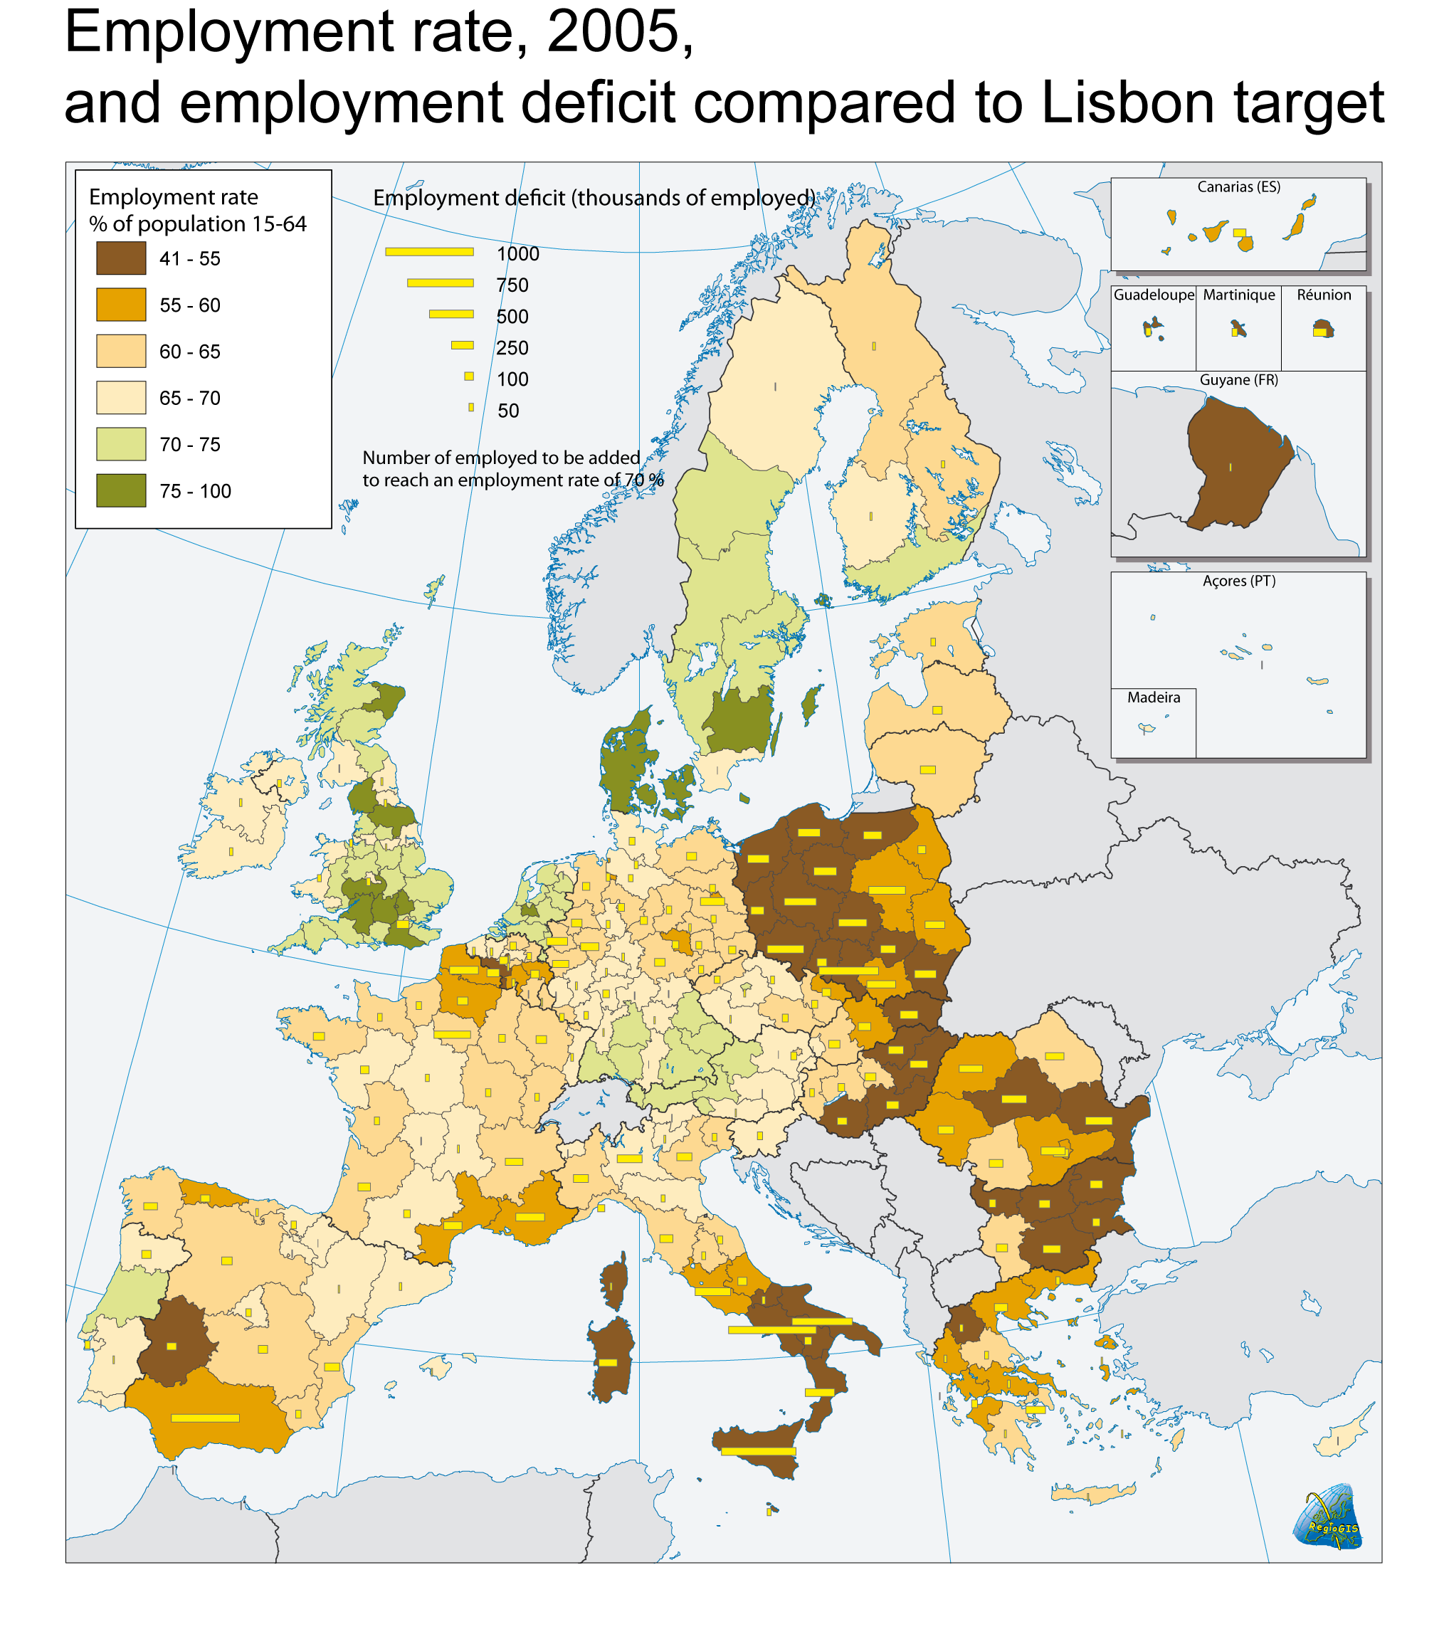

Slide 29
J: Employment rates
Lisbon target (70% of working age adults, 15-64 )
(Europe 2020 is 75% of 20-64 year olds)
EU27 at 65%
Scandanavia, NL over 70% (note part-time working women), now joined by AUT and DE (UK and CYP at about 70%)
contrast with Belgium…see Turkey!
central and eastern Europe traditionally higher than Med., but now…
all EU challenged again with economic crisis...

Slide 30
Sectors of employment
NACE classification (nomenclature of activities):
EU15:
  4.3% agriculture (Greece, Portugal higher)
  28.9% industry
  66.5% services
EU12:
  21.6% agriculture (esp. Poland, Romania)
  31.7% industry
  48.1% services

Slide 31
Employment by sector (2002)
% of total employment
AGRICULTURE
INDUSTRY
SERVICES
< 1.97
EU-27 = 7.0
< 22.73
EU-27 = 28.9
< 56.2
EU-27 = 84.1
1.97 – 3.18
22.73 – 26.49
56.2 – 62.44
3.18 – 5.28
26.49 – 30.58
62.44 – 67.89
5.28 – 9.96
30.58 – 33.85
67.89 – 73.54
>= 9.96
>= 33.85
>= 73.54
Source:
Eurostat (LFS)
no data
no data
no data

Slide 32
Priorities for the EU
after the financial crisis
Robin Smail

Slide 33
Lisbon & Gothenburg Agendas
EU competitiveness (by 2010...)
innovation and the knowledge society
employment targets (70% by 2010)
RTD targets (3% of GDP)
sustainable development
now called: " growth and jobs "

Slide 34
Building the Lisbon Agenda
linking Broad Economic Policy Guidelines (macro and micro economic)...
...to European Employment Strategy and National Employment Action Plans and recommendations...
and internal market reforms
to produce New Integrated Guidelines for Growth and Jobs (2005-2008) and...
... National Reform Programmes
with links to strategies and Programmes within Cohesion Policy

Slide 35
Competitiveness and innovation: measuring innovation
expenditure on RTD
  GERD (gross), BERD (business) etc
population with tertiary education
employment in medium/high-tech sectors
patent applications /high-tech patents
company expenditure on innovation
ICT expenditure
there is an Innovation Scoreboard
[See tables]

Slide 36
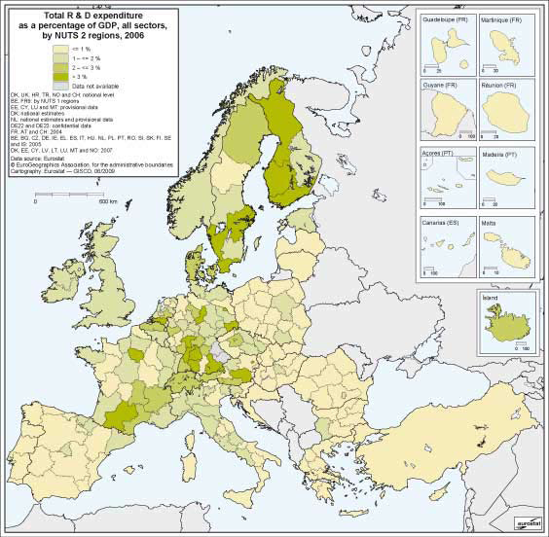
R&D intensity (GERD as % of GDP)

Slide 37
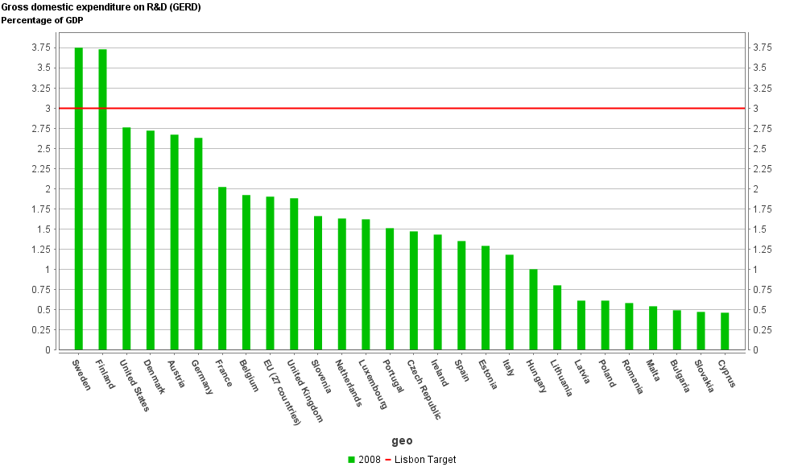
Gross Domestic Expenditure on R&D (GERD)
Source: Eurostat

Slide 38
GERD
http://epp.eurostat.ec.europa.eu

Slide 39
K. Tertiary education
(% of 25-64 age group with post-secondary qualifications)
Highlights:
EU average at 24%
(USA at 38%; Japan 37%)
Finland highest at 36%; others near 30%
Portugal, Italy, Poland, Slovakia, Malta and others under 20%
EU12 said to have good secondary education, weak tertiary sector
NB: definitions after data tables

Slide 40
K. Employment in Medium
& High-tech manufacturing
(% of "workforce")
Highlights:
EU25 average is 6.7%
Germany & CZ at 11%
central Europe over 8%...
lagging in Greece, Portugal & Baltic states

Slide 41
K. EPO Patent applications
(per million population)
Highlights:
Finland, Germany (around 270) ahead (RATE per million popln.)*
EU ave. (106) behind US and Japan (>150) at European Patent Office!
Cohesion countries very low
central and eastern European countries low on all patents
*(Can be number per €1 billion GDP)

Slide 42

Europe 2020

Slide 43
Europe 2020: objectives
smart growth: knowledge, innovation, education
sustainable growth: resource efficient, greener, more competitive
inclusive: high employment and cohesion
targets for 2020:
75% employment (NB: of 20 to 64 year olds) (currently 69%)
3% of GDP on R&D (currently 1.9%)
20/20/20 climate and energy targets (% cut, greenhouse gases; share of renewable energy sources; improve energy efficiency)
early school leavers (from 15% to under 10%); aim for 40% of 30-34 age group to get tertiary level degree /diploma (31% now)
reduce EU poverty levels by 25% (or 20 million people)

Slide 44
Europe 2020:
7 new EU-wide initiatives
“Innovation Union”: improve access to FPs etc. for R&D
helping educational quality
“digital agenda”: single digital market for firms and households
----------------------------------
low carbon economy (renewables; energy eff.)
improve business environment (for SMEs especially)
----------------------------------
improve labour market operation, labour mobility, lifecycle skills etc
“European platform against poverty” and social exclusion

Slide 45
Europe 2020: key/new features
7 flagship initiatives, linking EU and MS action
cohesion objective introduced
targets have been extended and refined
Member States still to deliver most actions, working with national recommendations and targets agreed at EU level
monitoring of progress at Council level (open method of coordination continues (OMC))
structural reform of public sector/services missing

Slide 46
Where next for the EU economy?
  European « Social » model versus free market (laissez-faire) economy? (What caused the crisis?)
    higher taxes; fewer incentives
    more protection; less extreme poverty
  will growth rates still be lower in the Euro zone after the recession?; unemployment higher?
  good performance in some parts of EU though
  employment rates and demographic changes imply the EU model is unsustainable
    pension and health care reform
    public sector burden
    immigration

